Slide 1
Unraveling Tangled Code
Jen McCown, Jen@MidnightDBA.com
SQLSaturday #223 Oklahoma | 8/24/2013

Slide 2
Jen McCown
Microsoft SQL Server MVP & DBA
MidnightDBA.com
Email: Jen@MidnightDBA.com
Blog: MidnightDBA.com/Jen
Twitter: @MidnightDBA
Webshow: DBAs@Midnight Fridays 11pm CST
DBARoadmap.com
MidnightSQL Consulting

Slide 3
Unraveling Tangled Code
Jen McCown, Jen@MidnightDBA.com
SQLSaturday #223 Oklahoma | 8/24/2013

Slide 4
Overview! Whee!!
Organize
Breakdown
Streamline

Slide 5
Overview: Organize
Format
Comment

Slide 6
Overview: Breakdown
Pseudocode
Structure and Plan of Attack
Columns and Returned Data
Table Sketch and Re-Engineering

Slide 7
Overview: Breakdown
Pseudocode
Structure and Plan of Attack
Columns and Returned Data
Table Sketch and Re-Engineering

Slide 8
Query Shape: UNION

Slide 9
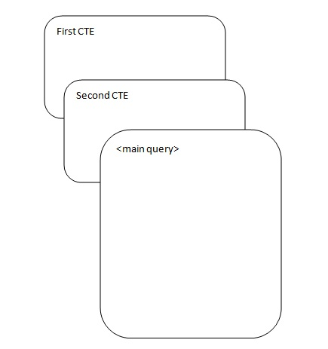
Query Shape: CTEs

Slide 10
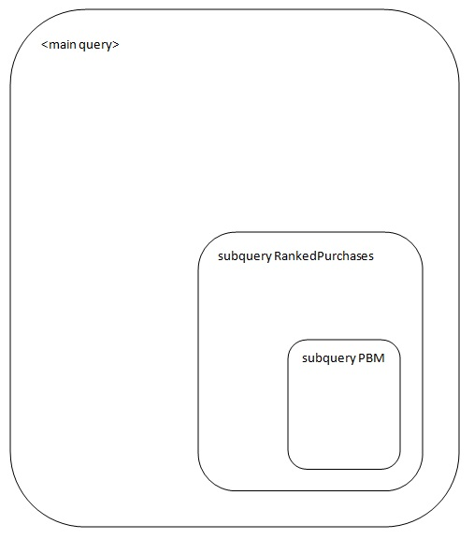
Query Shape: Subqueries

Slide 11
Overview: Breakdown
Pseudocode
Structure and Plan of Attack
Columns and Returned Data
Table Sketch and Re-Engineering

Slide 12
Overview: Breakdown
Pseudocode
Structure and Plan of Attack
Columns and Returned Data
Table Sketch and Re-Engineering

Slide 13
Sketch: PBM Subquery

Slide 14
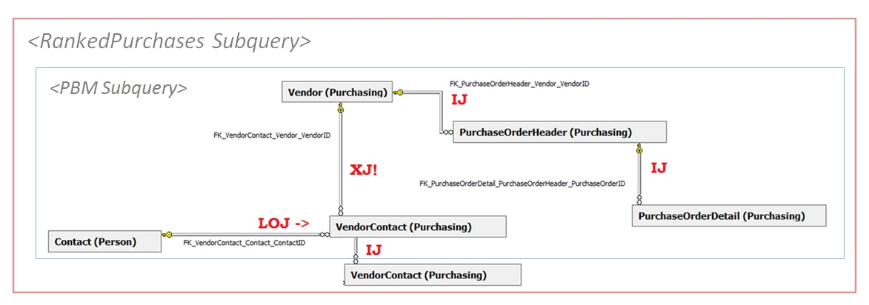
Sketch: RankedPurchases Subquery

Slide 15
Overview: Streamline
Obvious Issues
Extra rows or columns
Unnecessary work
NonSARGable WHERE clauses
Streamline JOINs
Similar Subqueries
Other

Slide 16
Summary
Format and comment code
Breakdown
Pseudocode
Structure and Plan of Attack
Columns Returned Data
Table Sketch and Re-Engineering
Streamline

Slide 17
Thanks!
All session materials and recording will be available at MidnightDBA.com/Jen
Contact me:
Jen@MidnightDBA.com
Twitter.com/MidnightDBA
Other resources:
MidnightDBA.com
SQLServerSamples.codeplex.com (AdventureWorks)
SSMSToolsPack.com
Redgate.com
SQLSentry.net/plan-explorer/

