Slide 1
When a Strange Server Calls
Jen McCown
www.MidnightDBA.com

Slide 2
Hi. I’m Jen.
MidnightDBA.com
MidnightSQL.com
Jen@MidnightDBA.com
Twitter: @MidnightDBA

Slide 3
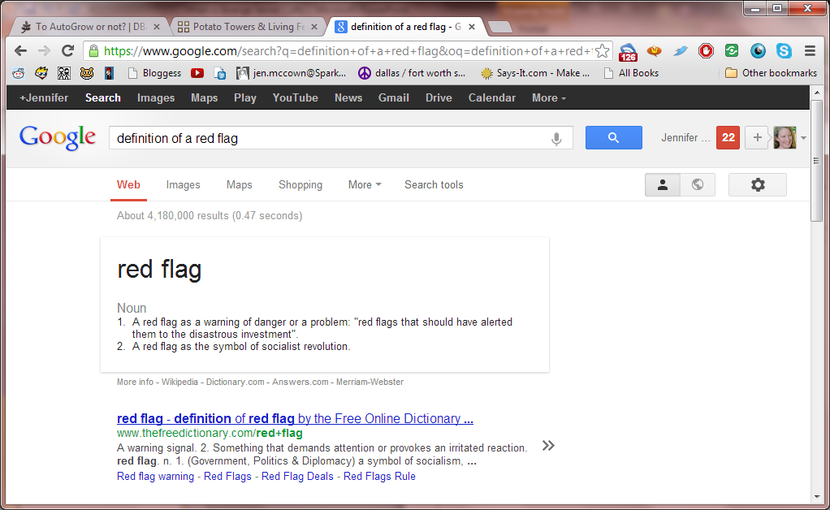
Let’s play “find the red flag”

Slide 4


Get Your Scope
There are no “universal” issues.
No
Nope

Slide 5
Evaluations
General “What is this?”
Performance “Why is it slow?”
Operational “What HAPPENED?”
Demo time…

Slide 6
Thanks!
You can download session materials at
MidnightDBA.com/Jen/StrangeServer
Check out the newly designed MidnightDBA.com
Come see us every Friday at 11pm Central for the
DBAs@Midnight webshow!
webshow.MidnightDBA.com

